Slide 1
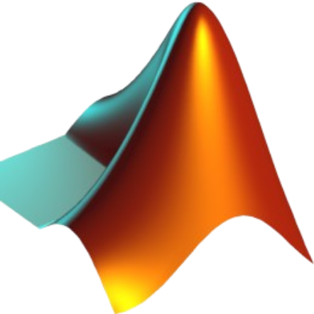
MATLAB
Ian Cornell

Slide 2
What is MATLAB
MATLAB is a high-performance programming language and computing platform.
Combines programming, visualization and computation

Slide 3
MATLAB meaning and Language Style
MATLAB stands for Matrix laboratory
MATLAB also known as Octave
Written similarly to C/C++
Runs on Windows, macOS, and Linux

Slide 4
Uses
Data Analysis
Algorithm development
Modeling and simulation
Scientific and engineering graphics
Engineering Control Systems
Deep learning models

Slide 5
Who Uses MATLAB
Engineers and Scientists: check equation solutions, optimize design
Researchers: advance their research
Data Scientists/ Analysts: Data extrapolation and correlation
Students: college-level math, science and engineering courses
NASA: accelerate development and testing of autonomous systems
Tesla: analyze test data and develop thermal models

Slide 6
Need to Knows
MATLAB is interactive, basic data element is an Array
Beginner-friendly and straightforward syntax
Similar to English
Quickly create programs, or create larger, complex applications

Slide 7
MATLAB Facts
How many people use MATLAB: 4.1 million as of May 2022
Python returned about 7.6 million users
Integrated documentation system
Performance: MATLAB can range from 42 to 100 times faster than python coding for the same project

Slide 8
Downside of MATLAB
Pricing: For a student license it is a single time purchase of $99. For standard it is $980 per year or $2450 for a lifetime license
Limited Open-Source Support
Steep Learning Curve for Beginners

Slide 9
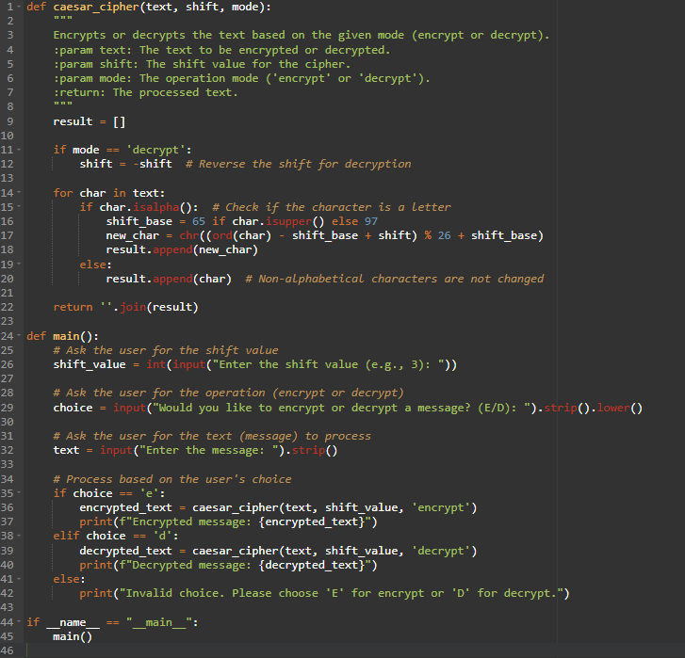
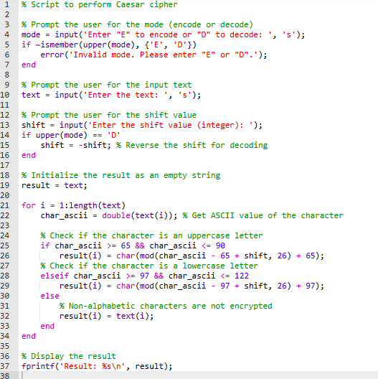
Demonstration (Caesar Cipher)
Python
MATLAB/Octave

Slide 10
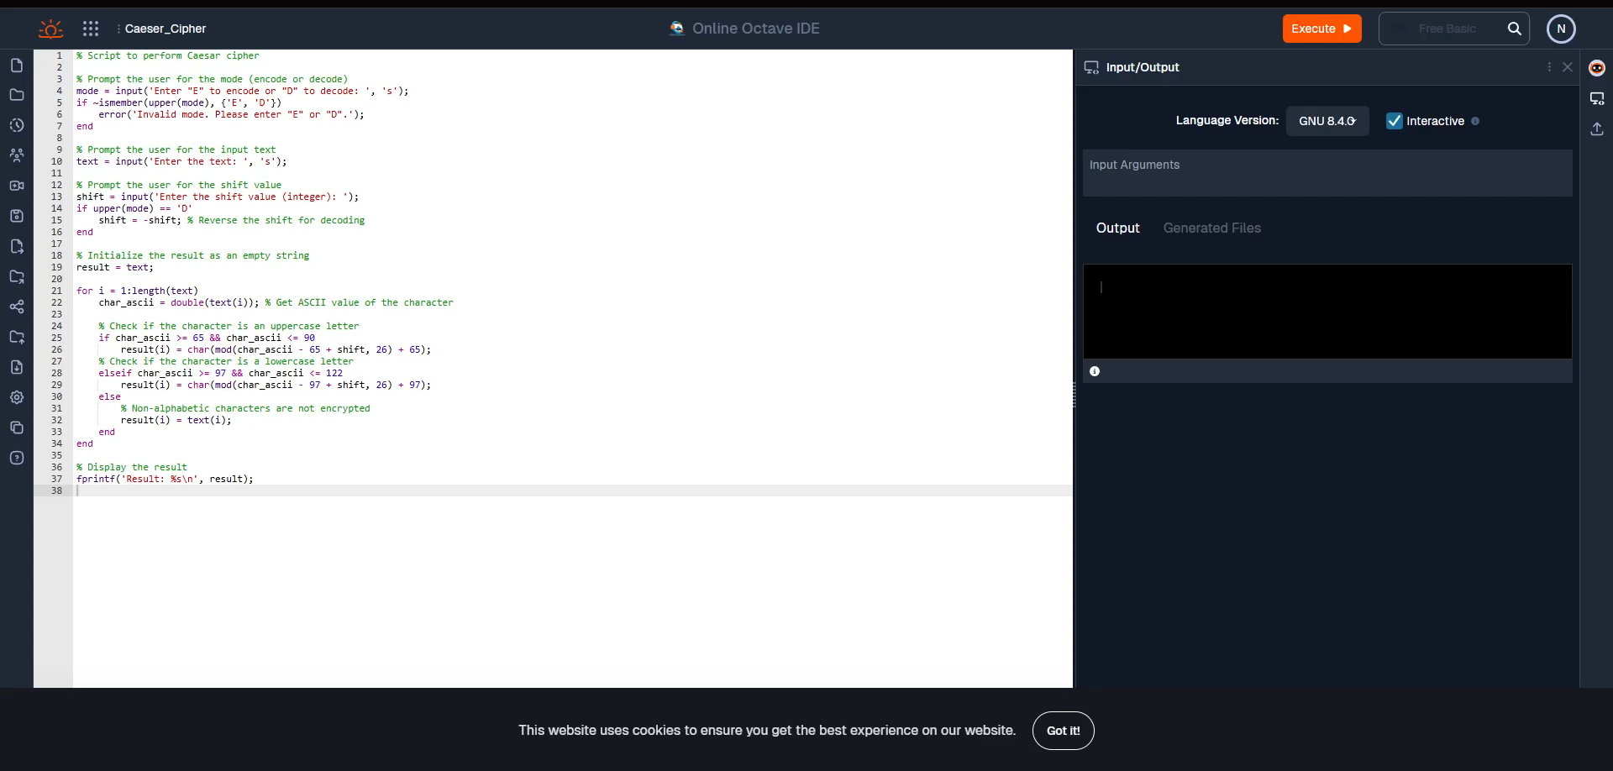
MATLAB Demo

Slide 11
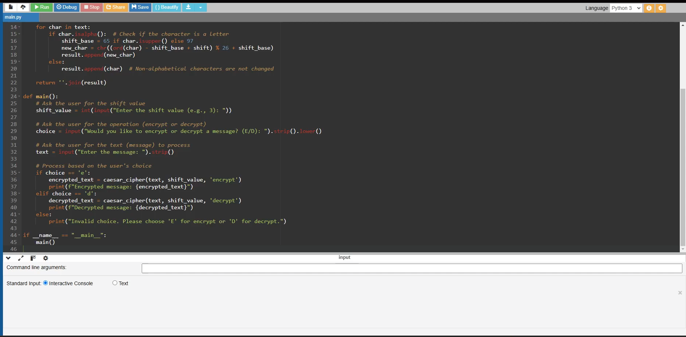
Python Demo

